Slide 1
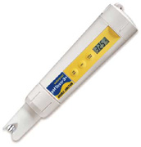
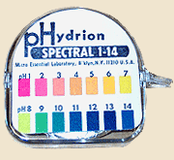
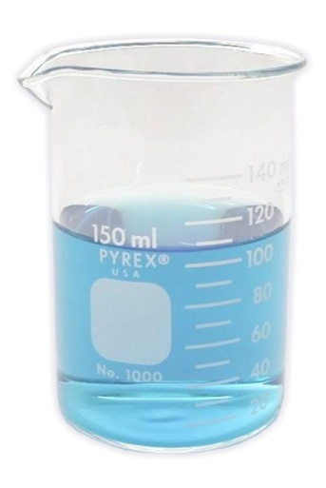
What is pH?

Slide 2
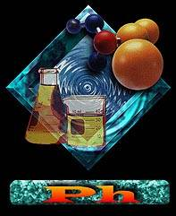
pH
A special name is given to the acid or base characteristic that a substance has:
It is called: pH
“p” stands for potential and “H” stands for hydrogen; hence, the potential of a substance to attract hydrogen ions

Slide 3
Acid
Any substance which has a pH of value of less than 7 is considered an acid
0--------------7---------------14
Acid Neutral Base

Slide 4
Base
Any substance which has pH value greater than 7 is a base
0--------------7---------------14
Acid Neutral Base

Slide 5
pH 7
A pH of 7 is called neutral—neither acid nor base.
0------------7------------14
Acid Neutral Base

Slide 6
Why pH of water = 7 ?
Because of Ionization of water

Slide 7
The pH Scale
pH scale ranges from 0 -14
pH 7 is neutral; neither acid nor base
Pure water is pH 7
Low pH (0-6.9) = acid
High pH (7.1-14) = base
The closer to the ends of the scale, the stronger the solution is

Slide 8
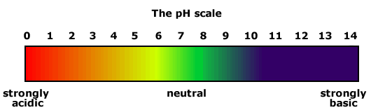
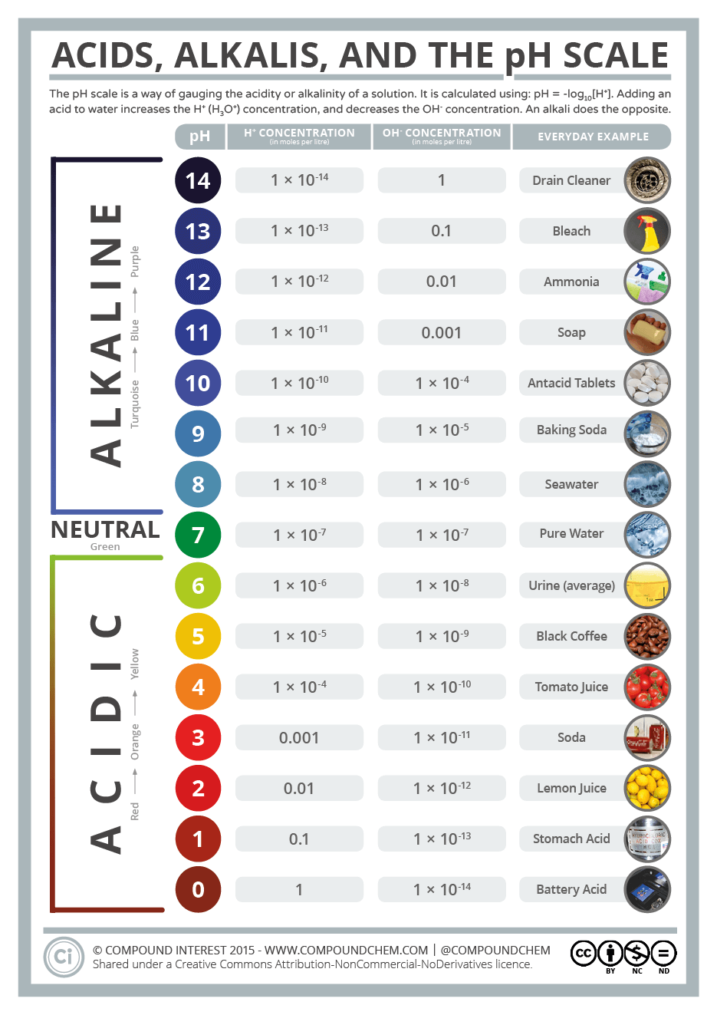

Slide 9
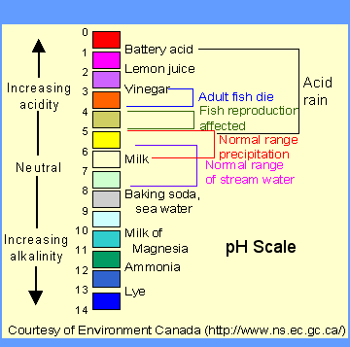
The pH Scale

Slide 10
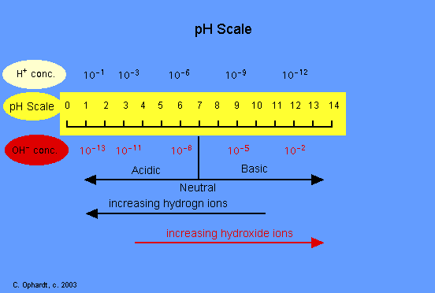
The pH Scale
Each pH unit is 10 times as large as the previous one
A change of 2 pH units means 100 times more basic or acidic
x10
x100

Slide 11
The pH Scale
Careful measurement is important
A mistake of one pH unit means 10 times too much or too little!
x10
x100

Slide 12
Acids and Bases
Chemicals may be classed as acids or bases.
Things that are neither acids nor bases are neutral.
pH measures how acidic or basic a solution is.

Slide 13
Acids
Often taste sour
Strong acids can burn skin & eyes
Strong acids can dissolve metals
Examples:
  Lemon juice
  Vinegar
  Car battery acid (dangerous!)

Slide 14
Bases
Can taste bitter, sweetish, or salty
Strong bases can burn skin & eyes
Bases react more easily with protein than with metal; they are often used for cleaning
Examples:
  Milk
  Baking soda
  Soap
  Drain cleaner (dangerous!)

Slide 15

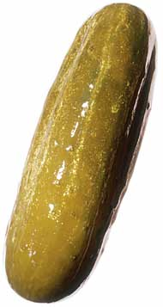
Acids and Bases
Some of our favorite foods make our tongue curl up because they are SOUR.

Slide 16
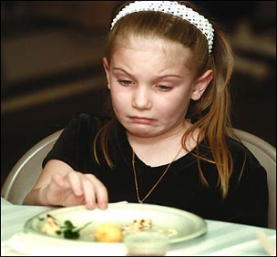
Bitter!
Some foods have a “bite” of their own because they’re somewhat bitter.
WHY?

Slide 17
Acidic/Basic
There is a scientific reason for this:
These foods are either acidic or basic.
Other substances besides foods have these characteristics.

Slide 18
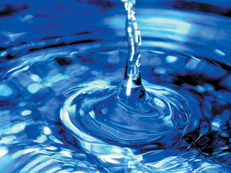
Some substances are not really an acid or a base: For example, pure water

Slide 19
How Do We Measure pH?
We measure pH by using special strips of paper called pH paper

Slide 20
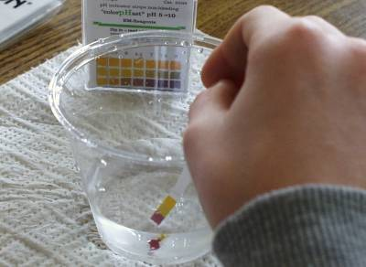
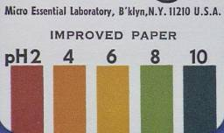
How Does It Work?
The paper is treated with chemicals that change color to show the pH.
When the paper touches the substance being tested, it turns a specific color to tell if the substance is an acid or a base.

Slide 21
To Use pH Paper
Place the edge of the pH paper into the mixture.
Observe the color change of the pH paper
Match the resulting color to the colors listed on the outside of the pH paper package.
The colors match with a correlated pH number.
The number is the pH value of the sample.

Slide 22
Acidic or Basic
If the number is less than 7 the substance or water is acidic
If the number is more than 7 the substance or water is basic

Slide 23
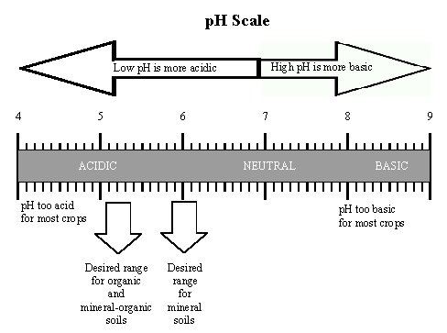
Why is pH important?
Fish can’t live if the pH is too high or too low
Soil has to be in a certain pH range for plants to grow and stay healthy.

Slide 24
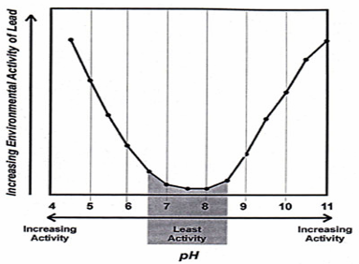
pH and People
Water that has too high or low pH contains harmful dissolved chemicals.
Water plant operators keep a careful watch on the pH of our drinking water, to keep it safe.
Notes:
Heavy metals, such as lead, react to changes in pH. Environmental regulations require drinking water to remain within a specific pH range to prevent lead and other metals from dissolving out of pipes and containers and entering the water.

Slide 25
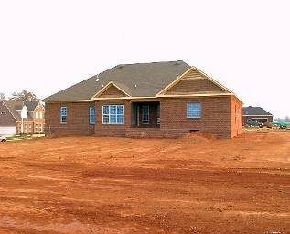
Most Substances:
Can be identified as either acidic or basic
Like the soil in our backyard.

